Slide 1


SOFTWARE ENGINEERING (Week-8)
USAMA MUSHARAF
MS-CS (Software Engineering)
LECTURER (Department of Computer Science)
FAST-NUCES PESHAWAR

Slide 2
AGENDA OF WEEK # 8
Architectural Styles
Categories of Architectural Style
Hierarchical Software Architecture
Layered
Data Flow Software Architecture
Pipe n Filter
Batch Sequential

Slide 3
ARCHITECTURAL STYLES
“A set of design rules that identify the kinds of components and connectors that may be used to compose a system.
The architectural style is a very specific solution to a particular software system, which typically focuses on how to organize the components created for the software.

Slide 4
COMPONENTS OF A STYLE
The key components of an architecture style are:
Elements/components
that perform functions required by a system
connectors
that enable communication, coordination, and cooperation among elements
constraints
that define how elements can be integrated to form the system
attributes
that describe the advantages and disadvantages of the chosen structure

Slide 5
CATEGORIES OF ARCHITECTURAL STYLES
Hierarchical Software Architecture
Layered
Data Flow Software Architecture
Pipe n Filter
Batch Sequential
Distributed Software Architecture
Client Server
Peer to Peer
REST
SOA
Microservices
Event Based Software Architecture
Data Centered Software Architecture
Black board
Shared Repository
Component-Based Software Architecture

Slide 6
HIERARCHICAL SOFTWARE ARCHITECTURE

Slide 7
HIERARCHICAL STYLE
The hierarchical software architecture is characterized by viewing the entire system as a hierarchy structure.
The software system is decomposed into logical modules (subsystems) at different levels in the hierarchy.

Slide 8
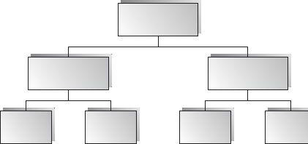
HIERARCHICAL STYLE
Modules at different levels are connected by method invocations.
a lower-level module provides services to its adjacent upper-level modules, which invokes the methods or procedures in the lower level.

Slide 9
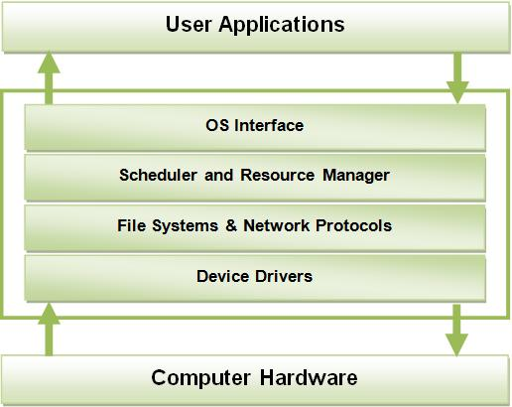
HIERARCHICAL STYLE
System software is typically designed using the hierarchical architecture style.

Slide 10
HIERARCHICAL STYLE
Lower levels provide more specific functionality down to fundamental utility services
such as I/O services, transaction, scheduling, and security services, etc.
Middle layers, in an application setting, provide more domain- dependent functions
such as business logic or core processing services.
Upper layers provide more abstract functionality in the form of user interfaces
such as command line interpreters, GUIs, etc.

Slide 11
LAYERED ARCHITECTURE

Slide 12
LAYERED STYLE
Organized hierarchically into layers.
Each layer provides service to the layer above it and serves as a client to the layer below.
The connectors are defined by the protocols that determine how the layers will interact.

Slide 13
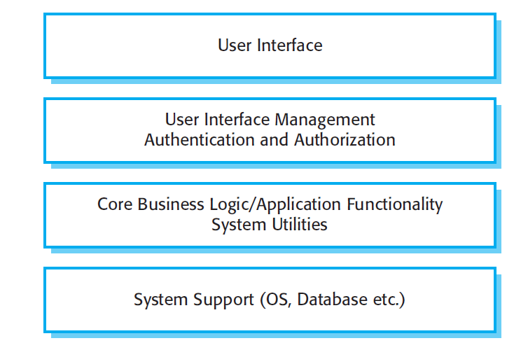
A GENERIC LAYERED ARCHITECTURE

Slide 14
LAYERED VIRTUAL MACHINE EXAMPLE: JAVA
Java
Java
Operating
Java Virtual Machine
Processor
(Virtual Machine Style)
System
Virtual Machine
Application

Slide 15
LAYERED SYSTEM EXAMPLE: OSI PROTOCOL STACK
Application
Application
Presentation
Presentation
Session
Session
Transport
Transport
Network
Network
Network
Network
Data Link
Data Link
Data Link
Data Link
Physical
Physical
Physical
Physical

Slide 16
APPLICABLE DOMAINS OF LAYERED ARCHITECTURE:
Any system that can be divided between the application-specific portions and platform-specific portions which provide generic services to the application of the system.
Applications that have clean divisions between core services, critical services, user interface services, etc.
Applications that have a number of classes that are closely related to each other so that they can be grouped together into a package to provide the services to others.

Slide 17
BENEFITS:
Incremental software development based on increasing levels of abstraction.
Enhanced independence of upper layer to lower layer since there is no impact from the changes of lower layer services as long as their interfaces remain unchanged.

Slide 18
BENEFITS (CONT..)
Enhanced flexibility: interchangeability and reusability are enhanced due to the separation of the standard interface and its implementation.
Promotion of portability: each layer can be an abstract machine deployed independently.

Slide 19
LIMITATIONS:
Lower runtime performance since a client's request or a response to a client must go through potentially several layers.
There are also performance concerns of overhead on the data processing and buffering by each layer.

Slide 20
LIMITATIONS (CONT..)
Breach of interlayer communication may cause deadlocks, and “bridging” may cause tight coupling.
Exceptions and error handling are issues in the layered architecture, since faults in one layer must propagate upward to all calling layers.

Slide 21
DATA FLOW SOFTWARE ARCHITECTURE

Slide 22
DATA FLOW ARCHITECTURES
The data flow software architecture style views the entire software system as a series of transformations on successive sets of data.
The software system is decomposed into data processing elements where data directs and controls the order of data computation processing.

Slide 23
DATA FLOW ARCHITECTURES
Each component in this architecture transforms its input data into corresponding output data.
In general, there is no interaction between the modules except for the output and the input data connections between subsystems.

Slide 24
DATA FLOW ARCHITECTURES
One subsystem can be substituted by another without affecting the rest of the system
Since each subsystem does not need to know the identity of any other subsystem, modifiability and reusability are important property attributes of the data flow architecture.
Example: Image Processing

Slide 25
BATCH SEQUENTIAL

Slide 26
BATCH – SEQUENTIAL
In batch sequential architecture, each data transformation subsystem or module cannot start its process until its previous subsystem completes its computation.
Data flow carries a batch of data as a whole from one subsystem to another.

Slide 27
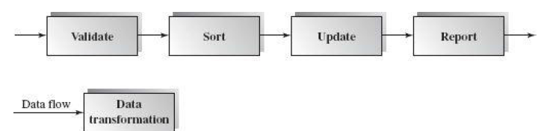
First subsystem validates the transaction requests (insert, delete, and update) in their totality.
Next, the second subsystem sorts all transaction records in an ascending order on the primary key of data records
The transaction update module updates the master file with the sorted transaction requests, and then
the report module generates a new list.
The architecture is in a linear data flow order.

Slide 28
BENEFITS:
• Simple divisions on subsystems.
• Each subsystem can be a stand-alone program working on input data and producing output data.

Slide 29
LIMITATIONS:
• It does not provide interactive interface.
• Concurrency is not supported and hence throughput remains low.
• High latency.

Slide 30
PIPES-AND-FILTERS STYLE

Slide 31
PIPE AND FILTER
This architecture decomposes the whole system into components of data source, filters, pipes, and data sinks.
The connections between components are data streams.
The particular property attribute of the pipe and filter architecture is its concurrent and incremented execution.

Slide 32
FILTER
Each filter is an independent data stream transformer;
it reads data from its input data stream, transforms and processes it, and then
writes the transformed data stream over a pipe for the next filter to process.

Slide 33
FILTER
A filter does not need to wait for batched data as a whole.
As soon as the data arrives through the connected pipe, the filter can start working right away.

Slide 34
PIPES
The connectors serve as channels for the streams, transmitting outputs of one filter to inputs of the other.
This makes connectors act as Pipes.

Slide 35
PIPES
A pipe moves a data stream from one filter to another.
A pipe is placed between two filters; these filters can run in separate threads of the same process.

Slide 36

STRUCTURE

Slide 37
EXAMPLES
Traditional Compilers:
Compilation phases are pipelined, though the phases are not always incremental. The phases in the pipeline include:
lexical analysis + syntax analysis (parsing) + semantic analysis + code optimization + code generation

Slide 38
EXAMPLE: ARCHITECTURE OF A COMPILER
Compilation is regarded as a sequential (pipeline) process.
Every phase is dependent on some data on the preceding phase.
text
Lex
Syn
Sem
Opt
CGen
code

Slide 39
BENEFITS:
Concurrency: It provides high overall throughput for excessive data processing.
Reusability: Encapsulation of filters makes it easy to plug and play, and to substitute.
Flexibility: It supports both sequential and parallel execution.

Slide 40
BENEFITS:
Modifiability: It features low coupling between filters, less impact from adding new filters, and modifying the implementation of any existing filters as long as the I/O interfaces are unchanged.
Simplicity: It offers clear division between any two filters connected by a pipe.

Slide 41
DISADVANTAGES
Not good choice for interactive systems, because of their transformational characteristic.

Slide 42
HAVE A GOO DAY!

